Slide 1

Twitter(X) Engagement Patterns: Time,
Content & Caption Analysis
Submitted by
Biswanath Kar
Akbar Ali Ansary
Anuskha Das
Suraj Ghosh
Snehamay Gayen
in partial fulfilment for the award
of
degree of Bachelor of Technology in Computer Science & Engineering – Data Science
in
Department of CSE-CS & DS, School of Engineering

Slide 2
Twitter(X) Engagement Patterns: Time, Content & Caption Analysis
Course Code: PROJ-CSD882
Course Title: Project II
Submitted by
Student Code | Roll Number | Registration Number | Name
BWU/BTD/22/123 | 22010333114 | 22013002019 of 2022-2023 | Biswanath Kar
BWU/BTD/22/141 | 22010333131 | 22013002036 of 2022-2023 | Akbar Ali Ansary
BWU/BTD/22/127 | 22010333118 | 22013002023 of 2022-2023 | Anushka Das
BWU/BTD/22/174 | 22010333162 | 22013002067 of 2022-2023 | Suraj Ghosh
BWU/BTD/22/173 | 22010333161 | 22013002066 of 2022-2023 | Snehamay Gayen
Project Supervisor
Mr. Partha Sankar Nayak

Slide 3
Acknowledgement
We are pleased to express my gratitude and regards towards my Project Guide Mr. Partha Shankar Nayak, Assistant Professor, Department of Computer Science and Engineering CS & DS, Brainware University, without whose valuable guidance, inspiration and attention towards us, pursuing my project would have been impossible. Last but not the least, We express our regards towards our friends and families for bearing with us and for being a source of constant motivation during the entire term of the work.

Slide 4
Content
Topic | Slide No.
Introduction……………….. | 5
Problem Statement………... | 6
Objective………………...... | 8
Workflow…………………. | 10
Model Evaluation…………. | 29
Result & Insights………….. | 23
Challenges………………… | 24
Future Scope……………… | 25
Conclusion………............... | 26
References………………… | 27
Thank You………………… | 28

Slide 5
Introduction
Social media platforms have significantly transformed global communication over the past two decades. X (formerly Twitter) is one of the most influential real-time social media platforms.
The platform is widely used for:
Breaking news
Political discussions
Brand marketing
Public opinion sharing
Key Features of Twitter/X
Real-time posting enables rapid information sharing.
Hashtags (#) help organize trends and topics.
Engagement metrics such as likes, retweets, and replies measure audience interaction.
Public API access supports research and data analysis.

Slide 6
Problem Statement
Massive amounts of tweet data are generated daily on X.
Manual analysis of tweets, opinions, and engagement patterns is difficult and time-consuming.
Tweet data is unstructured and contains:
Slang
Abbreviations
Emojis
URLs
@mentions
Hashtags
Multilingual text
Identifying public sentiment (positive, negative, neutral) from tweets is challenging.
Detecting trending topics and impactful hashtags manually is difficult due to rapidly changing trends.

Slide 7
Problem Statement
Businesses and marketers struggle to identify effective content strategies.
Existing systems often analyze sentiment, hashtags, and trends separately rather than in a unified framework.
There is a need for an automated Twitter Data Analytics system to:
Perform sentiment analysis
Detect trends
Analyze hashtags
Classify tweets using machine learning
Generate meaningful insights for better decision-making.

Slide 8
Objectives
The primary objective of this project is to develop an intelligent analytical framework capable of studying engagement patterns on X (formerly Twitter) by examining tweet timing, textual content, and caption characteristics. The system is designed to process large volumes of tweet data efficiently and generate meaningful insights that can support data driven social media strategies.
To collect, organise, and preprocess a large-scale Twitter dataset containing sufficient diversity of topics, sentiment, and temporal distribution to support robust analysis.
To perform accurate sentiment analysis classifying tweets into positive, negative, and neutral categories, achieving satisfactory precision, recall, and F1-score across all classes.
To conduct comprehensive time-series analysis on tweet activity, identifying statistically meaningful patterns in posting behaviour, peak engagement hours, and 5 temporal engagement distributions.

Slide 9
Objectives
To build a content recommendation system that retrieves and presents contextually relevant tweet content, suggested hashtags, and optimal posting times.
To identifying the most effective posting times and days for maximizing audience engagement, likes, shares, comments, and tweet visibility.
To create meaningful visualisations of all analytical outputs, including sentiment distributions, trend analyses, temporal patterns, and model performance metrics.

Slide 10
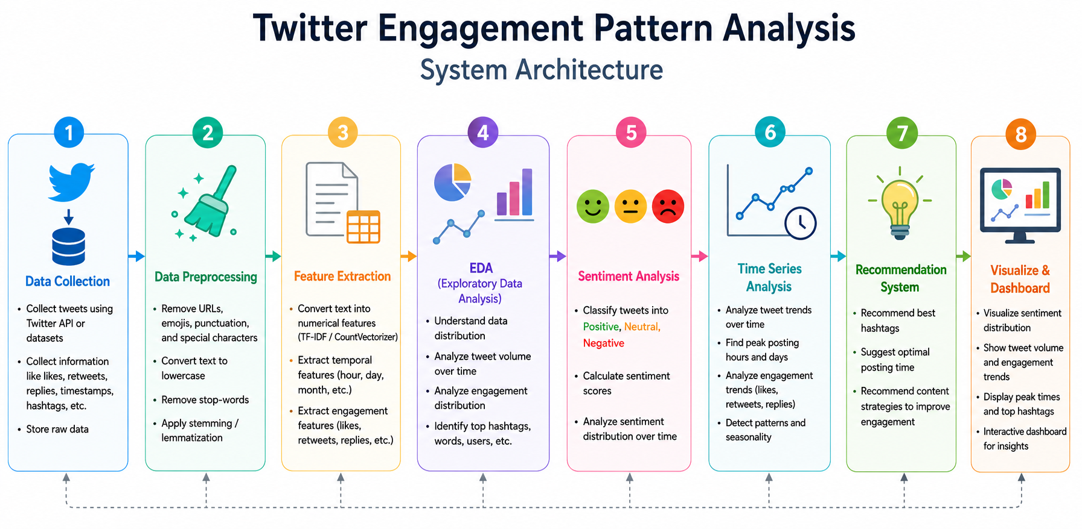
Workflow

Slide 11
Workflow
1. Data Collection
Collect tweets using Twitter/X API along with likes, retweets, replies, hashtags, and timestamps.
Source: Kaggle Twitter/X Dataset
54,091 tweets with 22 attributes
Includes likes, retweets, hashtags and datetime
Contains structured & unstructured data
2. Data Preprocessing
Clean the collected data by removing URLs, emojis, special characters, and stop words.
Missing Value Handling: Complete records for Text and Datetime columns
Text Cleaning: Noise-free, lowercased tweet text
Stopword Removal & Tokenisation: Meaningful keyword tokens per tweet
Datetime Processing: Standardised timestamps with Hour and DayOfWeek features

Slide 12
Workflow
3. Feature Extraction
Extract important features such as hashtags, keywords.
Textual Feature Extraction using TF-IDF: The project uses TF-IDF (Term Frequency–Inverse Document Frequency) for extracting important textual features such as keywords, hashtags, and frequently occurring words from tweets.
Sentiment Feature Extraction using NLP: Sentiment Label Generation Actual_Sentiment column (Positive/Negative/Neutral)

Slide 13
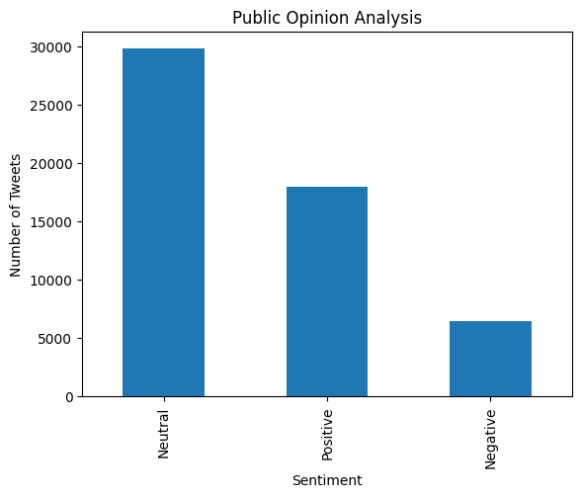
Workflow
4. Exploratory Data Analysis (EDA)
Analyze tweet patterns, trends, distributions, and user engagement visually.
4.1 Sentiment Distribution Analysis: The first EDA task examines the overall distribution of sentiment across the dataset. After applying TextBlob sentiment classification to all 54,091 tweets, the distribution was computed and visualised as a bar chart.
Sentiment:
Neutral 29772
Positive 17911
Negative 6412

Slide 14
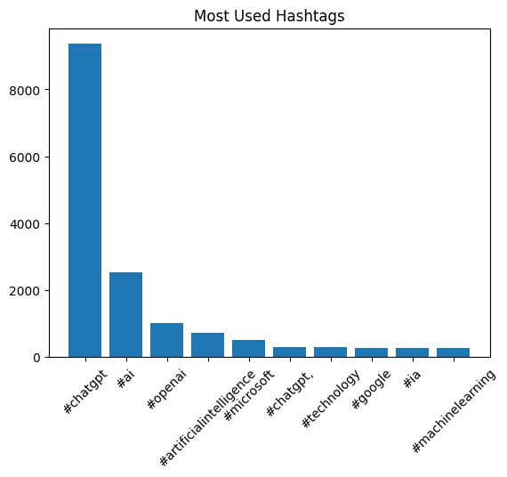
Workflow
4.2 Overall Most Used Hashtags
Hashtag Detection Hashtags are the primary organisational mechanism on Twitter. The hashtag analysis module extracts all hashtag tokens from tweets (words beginning with # ), computes their frequency distribution, and identifies the most impactful tags both globally and for specific topics.
Top Hashtags:
[('#chatgpt', 9367), ('#ai', 2525), ('#openai', 1010), ('#artificialintelligence', 721), ('#microsoft', 498), ('#chatgpt,', 305), ('#technology', 304), ('#google', 277)

Slide 15
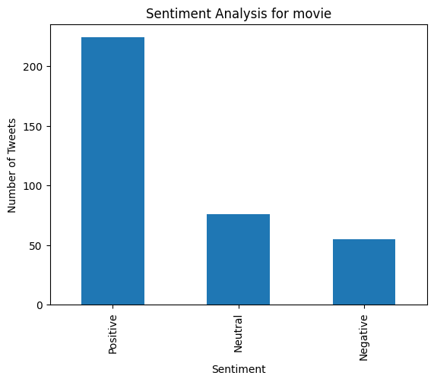
Workflow
5. Sentiment Analysis
5.1 Sentiment Analysis For
a Specific Topic
Enter topic: movie
Tweets found: 355
Sentiment Analysis for: movie
Positive 224
Neutral 76
Negative 55

Slide 16
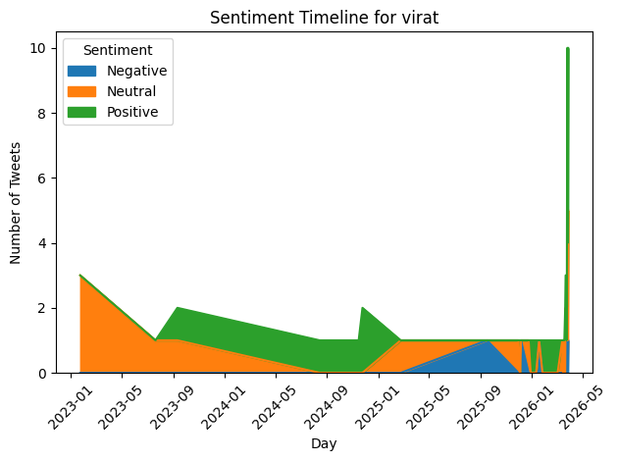
Workflow
6. Time Series Analysis
6.1 Sentiment Analysis Over Time
The analysis was performed on tweets related to Virat Kohli, where a total of 64 tweets were found. The sentiment trend shows that most tweets were positive, especially during March 2026, indicating strong public appreciation and support. Only a few negative tweets were observed, which means the overall sentiment toward Virat Kohli was mainly positive. The highest positive activity appeared on 2026-03-26 with 8 positive tweets, suggesting increased engagement or popularity on that date.
Enter topic: virat Kohli
Tweets found: 64

Slide 17
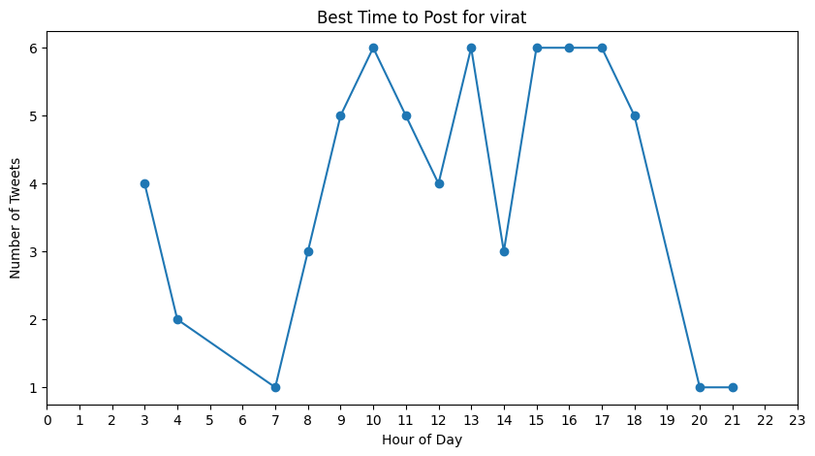
Workflow
6.2 Best Time To Post For a Specific Topic
According to the analysis, the best time to post about “virat” is around 10:00 AM, where tweet activity reaches one of its highest peaks. Additional high-engagement periods are also observed around 1:00 PM, 3:00 PM, 4:00 PM, and 5:00 PM, indicating that users remain highly active during late morning and afternoon hours.
Enter topic: virat
Tweets found: 64
Best time to post about virat is around: 10 :00

Slide 18
Workflow
7. Tweet Recommendation System
The TF-IDF based recommendation system was tested using the topic query “ipl” with the sentiment preference set to negative. After applying sentiment filtering, the system identified 6,412 tweets belonging to the negative sentiment category. This demonstrates the system’s ability to perform targeted filtering based on both topic relevance and emotional tone.
Enter topic: ipl
Enter sentiment (positive/negative/neutral): negative
Tweets after sentiment filter: 6412
📌 Recommended Tweets:
1. PSL had the contracts. IPL made one call.
9 players. 9 different franchises. Same decision.
Fraser-McGurk, Muzarabani, Gurbaz, Johnson, Mills. The moment an IPL spot opened up, the PSL contract meant nothing.

Slide 19
It's just the reality of world cricket in 2026.
This is the reality check for PSL.
Every league on the planet is essentially a waiting room for the IPL. Players show up, do their bit, and the moment that Mumbai or Bangalore call comes, bags are packed.
.
.
.
5. 🚨 IPL 2026 ALL TEAM CAPTAIN'S 🚨
• Ruturaj Gaikwad : (CSK)
• Hardik Pandya : (MI)
• Ajinkya Rahane : (KKR)
• Pat Cummins : (SRH)
• Rajat Patidar : (RCB)
• Shreyas Iyer : (PBKS)
🔥 Suggested Hashtags:
['#ipl2026', '#rcbvssrh']
⏰ Best Time to Post:
3:00 PM

Slide 20
Model Evaluation
Evaluation Strategy:
The dataset is split into training and test sets using an 80:20 ratio (random_state=42 for reproducibility):
Training Set: 43,272 records (80% of total)
Test Set: 10,819 records (20% of total)
The model is trained exclusively on the training set and evaluated on the unseen test set, ensuring unbiased performance estimation.
Classification Report
Class | Precision | Recall | F1-Score | Support
Negative | 0.83 | 0.43 | 0.57 | 1,698
Neutral | 0.81 | 0.95 | 0.87 | 5,439
Positive | 0.83 | 0.80 | 0.82 | 3,682
Accuracy |  |  | 0.82 | 10,819

Slide 21
Model Evaluation
Analysis of Results
The model achieved an overall accuracy of 82%, indicating reliable sentiment prediction performance.
The Neutral sentiment class achieved the highest recall (0.95), showing excellent detection of neutral tweets.
The Positive sentiment class achieved balanced precision and recall, resulting in strong classification performance.
The Negative sentiment class showed lower recall, indicating that some negative tweets were misclassified as neutral or positive.

Slide 22
Confusion Matrix Analysis
The confusion matrix provides a detailed view of prediction outcomes across all three sentiment classes:
Confusion Matrix Interpretation
735 negative tweets were correctly classified as negative.
5,172 neutral tweets were correctly classified as neutral.
2,949 positive tweets were correctly classified as positive.
The matrix also reveals misclassifications:
Some negative tweets were predicted as neutral or positive.
Certain positive tweets overlapped with neutral sentiment.
Neutral tweets occasionally showed confusion with other sentiment classes.
The confusion matrix helps evaluate the strengths and weaknesses of the classifier and provides insights improving future model performance.
Actual \ Predicted | Predicted Negative | Predicted Neutral | Predicted Positive
Actual Negative | 735 | 593 | 370
Actual Neutral | 50 | 5,172 | 217
Actual Positive | 98 | 635 | 2,949

Slide 23
Results & Insights
Strong Overall Accuracy (82%): The model achieved an overall accuracy of 82%, which means it correctly classified most tweets into their appropriate sentiment categories. This indicates good overall model performance.
Best Performance in Neutral Sentiment: The Neutral sentiment class achieved the highest classification performance among all categories. The model was highly effective in identifying tweets containing factual or emotionless content.
Balanced Positive Sentiment Prediction: The Positive sentiment class showed balanced precision and recall values, meaning the model predicted positive tweets accurately and consistently without many incorrect classifications.
Lower Recall for Negative Sentiment: The Negative sentiment category showed lower recall compared to other classes. This indicates that some negative tweets were incorrectly classified as positive or neutral by the model.
Possible Reason for Misclassification: Negative tweets on social media often contain sarcasm, mixed emotions, or informal language, which makes accurate classification more difficult for the model.

Slide 24
Challenges
Unstructured and Noisy Text
Tweets are among the noisiest textual data sources in existence. The combination of informal language, internet slang, abbreviations, mixed languages, emojis, embedded URLs, @mentions, and hashtags creates a preprocessing challenge that is substantially greater than standard NLP tasks.
Datetime Format Inconsistency
The Datetime column contained timestamps in multiple formats with varying timezone specifications (UTC offset, named timezone, no timezone). Standard pandas datetime parsing with a fixed format string failed on a significant proportion of records.
Hashtag Normalisation
Similar topics are discussed under multiple hashtag variants -- AI , #ai , #ArtificialIntelligence , #artificialintelligence , #ArtificialIntelligence2026 -- which appear as distinct tokens despite referring to the same concept.

Slide 25
Future Scope
The framework developed in this project provides a strong foundation for several high-value extensions and enhancements. The following directions represent the most promising avenues for future development:
Real-Time Data Integration
Future improvements can integrate the Twitter (X) API to collect and analyse tweets in real time. This will help the system detect live trends, monitor sentiments instantly, and provide dynamic posting recommendations using technologies like Apache Kafka and Apache Spark.
Engagement Prediction Model
The system can be enhanced with a prediction model that estimates likes, retweets, and replies before a tweet is posted. By analysing tweet content, hashtags, sentiment, and posting time, users can optimise their content for better engagement.
User-Specific Personalisation
Future versions can provide personalised recommendations by learning from a user’s historical engagement patterns. The system can analyse audience behaviour and posting preferences to suggest better content strategies tailored to individual creators.

Slide 26
Conclusion
This project has successfully developed a comprehensive, data-driven analytical framework for studying Twitter(X) engagement patterns. By integrating Natural Language Processing, machine learning, and data visualization the system provides a multi-dimensional view of the factors that influence audience engagement on one of the world most important social media platforms.
The project delivered the following concrete outcomes:
A comprehensive EDA framework covering sentiment distribution, trending topics, hashtag analysis, temporal patterns, and sentiment evolution over time.
A TF-IDF + cosine similarity recommendation engine that provides contextually relevant tweet suggestions, hashtag recommendations, and optimal posting time guidance.
A Logistic Regression sentiment classifier achieving 81.86% overall accuracy with consistent precision across all three sentiment classes.

Slide 27
References
[1] Pak, A., & Paroubek, P. (2010). Twitter as a Corpus for Sentiment Analysis and Opinion Mining. Proceedings of LREC 2010, Valletta, Malta. ELRA.
[2] Pang, B., Lee, L., & Vaithyanathan, S. (2002). Thumbs Up? Sentiment Classification Using Machine Learning Techniques. Proceedings of EMNLP 2002, Philadelphia, PA. ACL.
[3] Kwak, H., Lee, C., Park, H., & Moon, S. (2010). What is Twitter, a Social Network or a News Media? Proceedings of WWW 2010, Raleigh, NC, USA. ACM.
[4] Ramos, J. (2003). Using TF-IDF to Determine Word Relevance in Document Queries. Proceedings of the First Instructional Conference on Machine Learning, Piscataway, NJ.
[5] Salton, G., & McGill, M. J. (1983). Introduction to Modern Information Retrieval. McGraw-Hill, New York.
[6] Go, A., Bhayani, R., & Huang, L. (2009). Twitter Sentiment Classification Using Distant Supervision. Stanford University Technical Report, CS224N.
[7] Nakov, P., et al. (2016). SemEval-2016 Task 4: Sentiment Analysis in Twitter. Proceedings of SemEval 2016, San Diego, CA. ACL.

